Slide 1
Bengaluru House Price Prediction
Using Machine Learning

Slide 2
Objective
Now-a-days, buying a good house in city is a one of the goal in their life journey of middle class people. But, price of the house is not known for most of them.
So, there is chance to cheat them by selling small house for more price or scam them by frauds like frauds says low price for the house then market price . At last they get money from buyers and fool them without giving house.
To overcame this, our projects main to develop a model predict the approximate price of house in Bengaluru city by providing necessary details.
In project, model is developed by using Machine Learning algorithms which gives best accuracy.

Slide 3
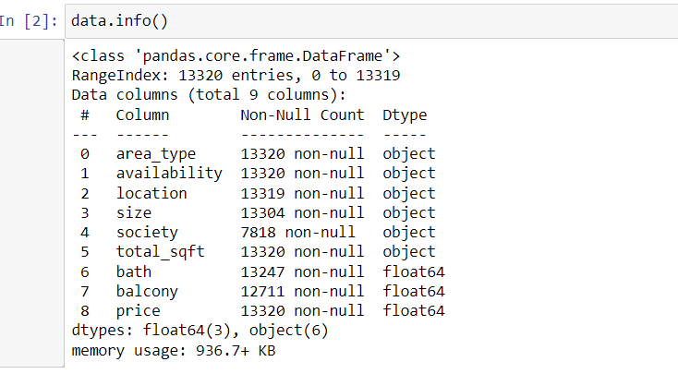
Dataset
Mentor provided dataset is used to develop the machine learning model
Above are the information about given dataset

Slide 4
Data Cleaning/Preprocessing
At first, dropped the unwanted columns society and availability which have high null values nearly 5000
At first, dropped the detected null value records and duplicate records from dataset
Converted categorical and string data type to required data type
Feature engineered some columns like price per square feet, price per bhk, square per bhk
Detected outliers by data visualization

Slide 5
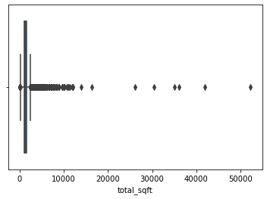
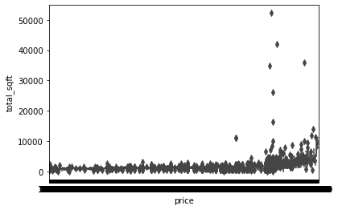
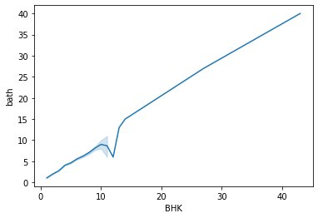
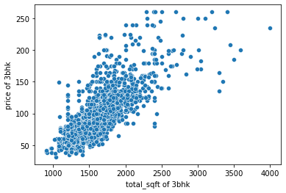
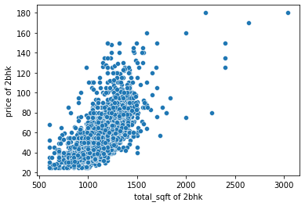
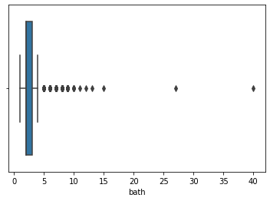
Data Visualization

Slide 6
Data Cleaning
Removing outliers by business rule
Removing outliers by interquartile rule
Removing outliers by mean and standard deviation using price per square feet future
Removing outliers by the case that in same location, big house price is equal to or less than the small house price

Slide 7
Model Building
Split into dependent and independent features
Then dataset is split into train and test datasets
Linear Regression , Lasso, Ridge, KNN, Random Forest, Decision Tree, SVM models are used for prediction

Slide 8
Accuracy
At last accuracy given by models are
KNeighbors :72.60530007771389 %
Decision Tree :69.63842294636255 %
Random Forest :79.61157090479727 %
SVM :72.55114531318987 %
Ridge :82.87832603147729 %
Lasso :82.89695655082494 %
Linear Regression:82.87478645646552 %
Conclusion
Lasso Gives High accuracy than other models

